Slide 1
9 Deadlocks (2 lots)
Chapter 6
Resources Introduction To Deadlocks The Ostrich Algorithm Deadlock Dectection & Recovery Deadlock Avoidance Deadlock Prevention Other Issues

Slide 2
Objectives
Resources
Preemptable (ưu tiên) and Nonpreemptable Resources
Resource Acquisition – Giành tài nguyên
Introduction To Deadlocks
Conditions for Resource Deadlocks
Deadlock Modeling
The Ostrich Algorithm (đà điểu có thói quen tắm cát)
Deadlock Detection & Recovery
Deadlock Detection with One Resource of Each Type
Deadlock Detection with Multiple Resources of Each Type
Recovery from Deadlock

Slide 3
Objectives …
Deadlock avoidance
Resource Trajectories – Đường đi của tài nguyên
Safe and Unsafe States
The Banker’s Algorithms for a Single Resource
The Banker’s Algorithms for a Multiple Resource
Deadlock Prevention
Attacking the Mutual Exclusion Condition – Khử loại trừ hỗ tương
Attacking the Hole and Wait Condition
Attacking the No Preemption Condition
Attacking the Circular Wait Condition
Other Issues
Two-Phase Locking
Communication Deadlocks
Live Lock
Starvation

Slide 4
Overviews
A resource can only be used by one process at a time.
All OS have the ability to (temporarily) grant a process exclusive access to certain resources.
A process needs exclusive access some resources.
A set of blocked processes each holding a resource and waiting to acquire a resource held by another process in the set, thus they will remain so forever (deadlocks).
Deadlock does not occur only on local machine but also across machines.
Deadlocks can occur in a variety of different situations such as requesting dedicated I/O devices, on hardware or software resources.
Notes:
1 tài nguyên có thể được dung bởi 1 tiến trình tại 1 thời điểm.
Tất cả có hệ điều hành có thể cấp phát cho mỗi tiến trình khả năng sử dụng độc lập 1 tài nguyên
1 process càn truy cập độc lập nhiều tài nguyên

Slide 5
Resources
Refer the objects as hardware devices, data records, files, etc .. that must be granted, acquired, used and released.
A computer will normally have many different resources
Some resource is the identical instances may be available
Some resource is copied of a resource available
There are two type resources
Preemptable (ưu tiên)/ nonpreemptable resource

Slide 6
Resources: Preemptable
Resource that can be taken away from the process owning it with no ill effects (either on system or others).
Preemptable resources can be resolved deadlocks by reallocating resources from one process to another.
Ex:
A system with 256 MB of user memory, one printer, and two 256-MB processes that each wants to print some thing.
Process A requests and gets the printer, then starts to compute the values to print. Before it has finished with the computation, it exceeds its time quantum and is swapped out (Process A has the printer, but it locates on disk)
Process B now runs and tries, unsuccessfully to acquire the printer (Process B locates on memory, but it cannot access the printer)
→ Process A take away the B’s memory by swapping process B out & swapping process A in. After finished, process A releases both.

Slide 7
Resources: Nonpreemptable
Resource cannot taken away from its current owner without causing the computation to fail.
Ex: if the process has begun to burn a CD-ROM, suddenly the CD recorder is taken away from it and giving it to another process will result in a garbled (sai lạc) CD.
Deadlocks involve nonpreemptable resources.

Slide 8
Resources: Resource Acquisition
The sequence of events required to use resource:
Request → Use → Release the resource
One of way allowing user management of resources is to associate a semaphore with each resource:
The semaphores are all initialized to 1.
A down to acquire the resource, using the resource.
A up on the resource to release resource.
Notes:
Hàng động tuần tự để sử dụng tài nguyên

Slide 9
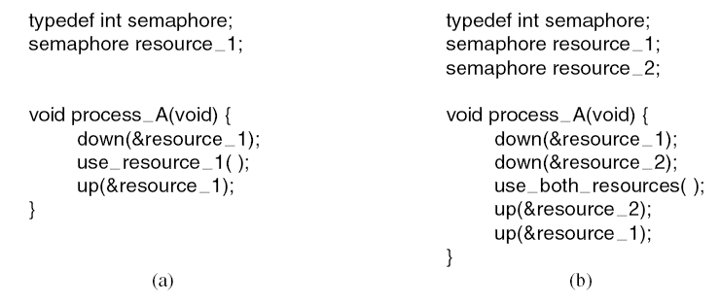
Resources: Resource Acquisition
The semaphores are all initialized to 1.
A down to acquire the resource, using the resource.
A up on the resource to release resource.
Using semaphore to protect resources
(a) One resource. (b) Two resources
Tanenbaum, Fig. 6-1.

Slide 10
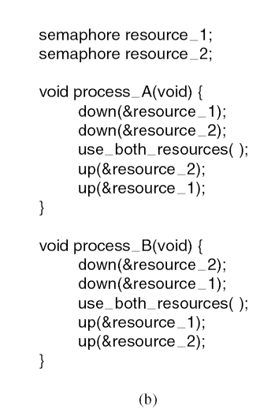
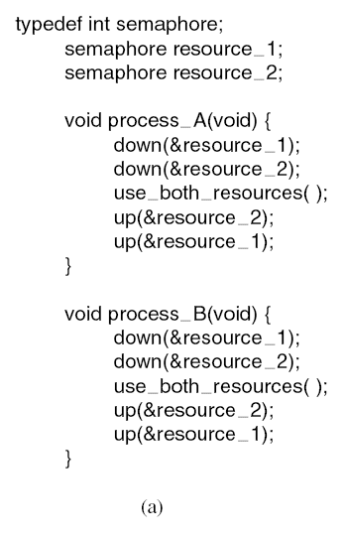
Resources: Resource Acquisition
Observe the order of resources used.
(a): Deadlock-free code. (b) Code with a potential deadlock
Tanenbaum, Fig. 6-2.

Slide 11
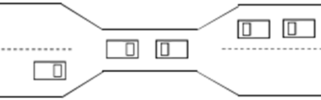
Introduction to Deadlocks
A set of processes is deadlocked if each process in the set is waiting for an event that only another process in the set can cause. When the deadlock occurs:
None of processes can run.
None of them can release any resources.
None of them can be awakened.
➔All the processes continue to wait forever.
Assume
Processes have only a single thread and
there are no interrupts possible to wake up a blocked processes.

Slide 12
Introduction to Deadlocks
Conditionals for Resource Deadlocks
Four conditions must hold for there to be a resource deadlock
Mutual exclusion condition (loại trừ hỗ tương)
Each resource is either currently assigned to exactly one process or is available
Hold and wait condition.
A process currently holding at least one resource is waiting to acquire additional resources held by other processes
No preemption condition.
A resource can be released only voluntarily (tự nguyện) by the process holding it, after that process has completed its task
Circular wait condition
There must be a circular chain of two or more process, each of them is waiting for a resource held by the next member of the chain.

Slide 13




Introduction to Deadlocks Deadlock Modeling
Four conditions for resource deadlocks can be modeled using directed graphs (Holt – 1972)
Two kinds of nodes
Processes that are shown as circles
Resources that are shown as squares
A directed arc from a resource to process: The process is holding an instance of resource.
A directed arc from a process to resource: The process is currently blocked and requests instance of resource
Tanenbaum, Fig. 6-3.

Slide 14
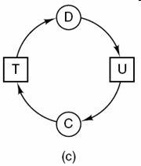
Introduction to Deadlocks
Deadlock Modeling – Examples
Circular wait condition: Deadlock
Tanenbaum, Fig. 6-3

Slide 15
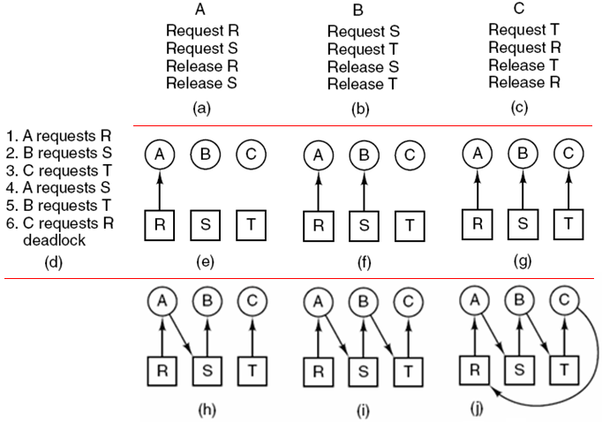
Introduction to Deadlocks Deadlock Modeling – Examples
Three processes A, B, C run concurrently.
List of resources required.
Deadlock
Tanenbaum, Fig. 6-4.

Slide 16
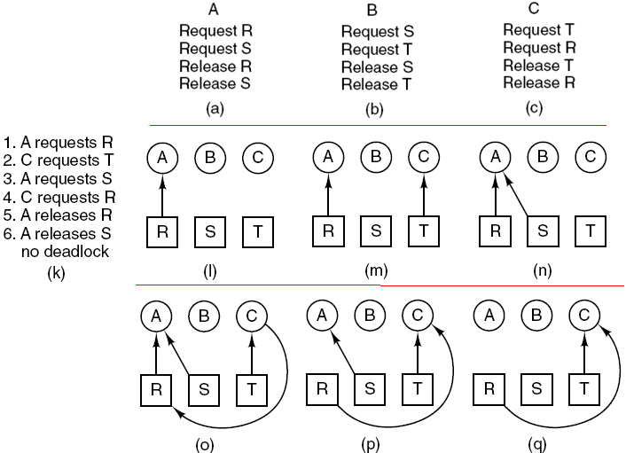
Introduction to Deadlocks Deadlock Modeling – Examples
Situation without deadlock
Tanenbaum, Fig. 6-4

Slide 17
Introduction to Deadlocks
Deadlock Modeling
Resource graphs are a tool that
Let see of a given request/ release request sequence leads to deadlock.
Help carrying out the requests and releases step by step, and after every step check the graph to see if it contains any cycles to check deadlock or not.
Can generalized to handle either single or multiple resource.
Basic facts
If graph contains no cycles → no deadlock
If graph contains a cycle
If only one instance per resource type, then deadlock
If several instances per resource type, possibility of deadlock

Slide 18
Introduction to Deadlocks Deadlock Modeling
Strategies for dealing with deadlocks
Just ignore the problem
Maybe if you ignore it, it will ignore you
Detection and recovery.
Let deadlocks occur, detect them, take action.
Dynamic avoidance by careful resource allocation.
Prevention, by structurally negating (phủ định) one of the four required conditions.

Slide 19
The Ostrich Algorithms
Just ignore the problem: Stick your head in the sand and pretend is no problem at all (đà điểu thích tắm cát).
Different people react in different ways:
Mathematicians
Totally unacceptable and must prevent deadlocks at all costs
Engineers
Would not be willing pay a large penalty in performance or convenience to eliminate deadlocks
OS blocks caller that requests the busy device. The device driver decide blocking or returning an error code.
Notes:
Pretend: làm ra vẻ

Slide 20
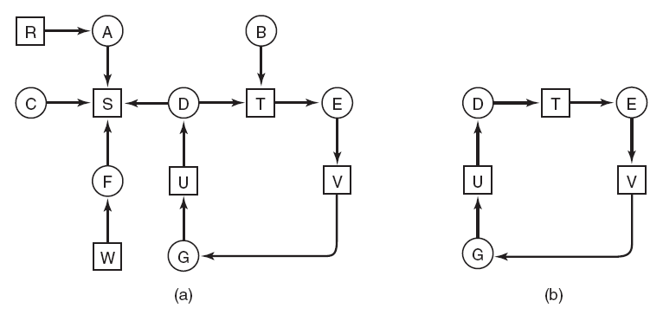
Deadlock Detection & Recovery Deadlock Detection with One Resource of Each Type
(a) A resource graph. (b) A cycle extracted from (a)
Tanenbaum, Fig. 6-5.

Slide 21
Deadlock Detection & Recovery Deadlock Detection with One Resource of Each Type
Algorithm for detecting deadlock: Detecting a cycle
For each node, N in the graph, perform the following five steps with N as the starting node.
Initialize L to the empty list, designate all arcs as unmarked.
Add current node to end of L, check to see if node now appears in L two times. If it does, graph contains a cycle (listed in L), algorithm terminates.
From given node, see if any unmarked outgoing arcs. If so, go to step 5; if not, go to step 6.
Pick an unmarked outgoing arc at random and mark it. Then follow it to the new current node and go to step 3.
If this is initial node, graph does not contain any cycles, algorithm terminates. Otherwise, dead end. Remove it, go back to previous node, make that one current node, go to step 3.

Slide 22
Deadlock Detection & Recovery Deadlock Detection with Multiple Resource of Each Type
A matrix-based algorithm among n processes, P₁ through P_{n} and m resource classes, E₁ through E_{m}
Let E be the existing resource vector that gives the total number of instance of each resource in existence
Let A be the available resource vector, with A_{i} giving the number of instances of resource i that are current available/ unsigned
Let C be the current allocation matrix, with
The i-th row of C tells how many instances of each resource class P_{i} currently holds
C_{ij} is the number of instances of resource j that P_{i} holds
Let R be the request matrix, with
The i-th row of P tells how many instances of each resource class P_{i} currently wants
R_{ij} is the number of instances of resource j that P_{i} wants

Slide 23
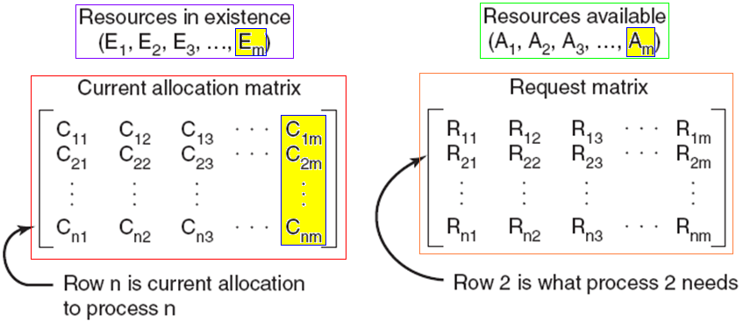
Deadlock Detection & Recovery Deadlock Detection with Multiple Resource of Each Type
Four data structures needed by the deadlock dectection algorithm
Tanenbaum, Fig. 6-6

Slide 24
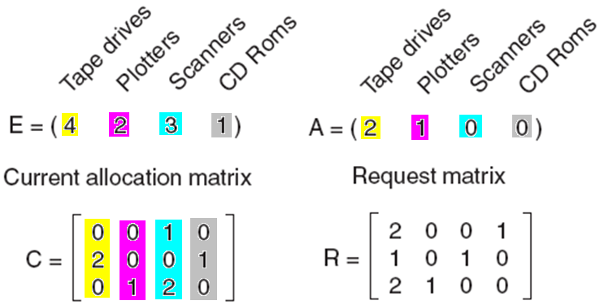
Deadlock Detection & Recovery Deadlock Detection with Multiple Resource of Each Type
A situation of E, A, C, R
Tanenbaum, Fig. 6.7

Slide 25
Deadlock Detection & Recovery Deadlock Detection with Multiple Resource of Each Type
Each process is initially said to be unmarked.
Deadlock detection algorithm
Look for an unmarked process, P_{i}, for which the R_{i} is less than or equal to A. (tìm dòng R_{i} có R_{ij}<=A_{j}, với mọi j ➔ có thể cấp phát tài nguyên thành công)
If such a process is found, add C_{i} to A, mark the process, and go back to step 1.
If no such process exists, the algorithm terminates
As the algorithm progresses, processes will be marked, indicating that they are able to complete and are thus not deadlocked
When the algorithm terminates, any unmarked processes are known to be deadlocked
This algorithm assumes a worst-case scenario: all processes keep all acquired resources until they exit.

Slide 26
Deadlock Detection & Recovery Deadlock Detection with Multiple Resource of Each Type
E=( 4 2 3 1) : Tapes, plotters, scanners, CD roms
C | A | R | Desciption (Run deadlock detection alg., Fig. 6-7
0 0 1 0 2 0 0 1 0 1 2 0 | 2 1 0 0 | 2 0 0 1 1 0 1 0 2 1 0 0 | i=1, dòng R₁ không thoả mãn vì không còn CD Rom → Khoá P1 i=2, dòng R₂ không thoả mãn vì không còn scanner → Khoá P2 i=3: R₃ thoả mãn → Đánh dấu Process P3 → cấp tài nguyên
0 0 1 0 2 0 0 1 2 2 2 0 | 0 0 0 0 | 2 0 0 1 1 0 1 0 0 0 0 0 | Chờ P3 trả tài nguyên khi P3 kết thúc
0 0 1 0 2 0 0 1 0 0 0 0 | 2 2 2 0 | 2 0 0 1 1 0 1 0 0 0 0 0 | P3 trả tài nguyên, R₂ thoả mãn, cấp tài nguyên cho P2
0 0 1 0 3 0 1 1 0 0 0 0 | 1 2 1 0 | 2 0 0 1 0 0 0 0 0 0 0 0 | P2 thực thi, R₁ không thoả mãn → chờ P2 thực thi xong P2 thực thi xong
0 0 1 0 0 0 0 0 0 0 0 0 | 4 2 2 1 | 2 0 0 1 0 0 0 0 0 0 0 0 | P2 trả tài nguyên R1 thoả mản, P1 được cấp tài nguyên
2 0 1 1 0 0 0 0 0 0 0 0 | 2 2 2 0 | 0 0 0 0 0 0 0 0 0 0 0 0 | Chờ P1 thực thi xong

Slide 27
Deadlock Detection & Recovery Deadlock Detection with Multiple Resource of Each Type
E=( 7 4 6) - Do yourself
C | A | R | Desciption (Run deadlock detection algorithm)
0 1 0 2 0 0 3 0 3 2 1 1 0 2 2 | 0 0 0 | 0 0 0 2 0 2 0 0 0 1 0 0 0 0 2

Slide 28
Deadlock Detection & Recovery Recovery from Deadlock
Recovery through Preemption
The ability to take a resource away from a process to allocate it to another process, and then give it back without the process noticing it is highly dependent on the nature of the resource.
It may be possible to temporarily take a resource away from its current owner and give it to another process.
Choosing the process to suspends largely on which ones have resources that can easily be taken back.
In many cases, manual intervention may be required, especially in batch processing OS running on mainframes
➔ It is frequently difficult or impossible.
Notes:
Intervention: sự can thiệp vào

Slide 29
Deadlock Detection & Recovery Recovery through Rollback
Checkpoint
Periodically, each process state is written to system file (memory image, resource state assigned to the process) so that it can be restarted later.
To be most effective, new checkpoints should not overwrite old ones but should be written to new files, so as the process execute, a whole sequence accumulates.
Recovery
When a deadlock is detected, a process is reset to an earlier checkpoint that did not have the resource.
Then, the resource is assigned to one of the deadlock processes
If the restarted process tries to acquire the resource again, it will have to wait until the resource becomes available.

Slide 30
Deadlock Detection & Recovery Recovery through Killing Processes
Kill one or more process(es) in the cycle (it’s crudest -thô thiển- but simplest)
First approach
Repeating until the cycle is broken
Kill process in the cycle
Check the cycle, if so, go back to the first line
Second approach
A process not in a cycle can be chosen as the victim in order to release its resource.
The process to be killed is carefully chosen because it is holding resources that some processes in the cycle need it.
Notes: The process victim should be chosen only if it can be re-run from the beginning with no ill effects.

Slide 31
Deadlock Avoidance Context
In most system, resources are requested one at a time (does not ask resources all at one).
The system must be able to decide whether granting a resource is safe or not and only make the allocation when it is safe.
Is there an algorithm that can always avoid deadlock by making the right choice all the time?
Yes, the deadlock can be avoided, but only if certain information is available in advance.
➔ Resources are allocated carefully.

Slide 32
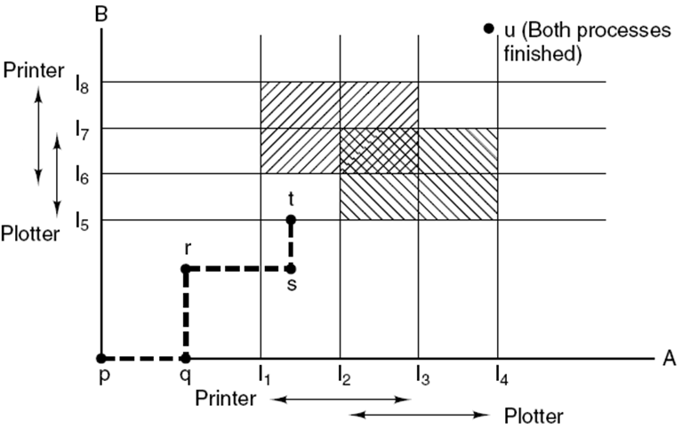
Deadlock Avoidance Resource Trajectories
The plotter is needed by both processes.
Resources needed
Instructions of the process B
Instructions of the process A
Resources needed
Two process resource trajectories
Tanenbaum, Fig. 6-8.
Notes:
Trajectry: đường đi

Slide 33
Deadlock Avoidance Safe and Unsafe States
A state is said to be safe if there is some scheduling order in which every process can run to completion even if all of them suddenly request their maximum number of resources immediately.
A system is in a safe state only if there exists a safe sequence.
Let n process in order P₁ … P_{n}. Each process is a safe sequence for current allocation state if:
For each P_{i}, the resources that P_{i} still request can be satisfied by the currently available resources plus the resources held by all the P_{j}, with j < i. If the resource that P_{i} needs are not immediately available, the P_{i} can wait until all P_{j} have finished ( j < i). When P_{i} terminates, the P_{i+1} can obtain its needed resource.
This condition does not satisfied → the system state is unsafe.

Slide 34
Deadlock Avoidance Safe and Unsafe States
Basic fact
If a system is in safe state → no deadlocks
If a system is in unsafe state → possibility of deadlock
To avoidance deadlocks → ensure that a system will never enter an unsafe state.

Slide 35
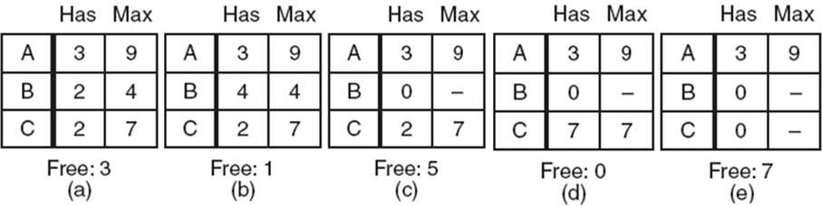
Deadlock Avoidance Safe and Unsafe States – Demo. 1
3 processes, 1 resource with 10 instances: Situation for safe state.
Tanenbaum, Fig. 6-9
(1) Fig (a) → B runs excusively → B requests 2 → fig. (b) → B terminates, B’s resources are deallocated → fig. (c) → C runs exclusively then requests resources → fig. (d) → C terminates, resources are deallocated → fig. (e) → A runs ➔ Safe state.

Slide 36
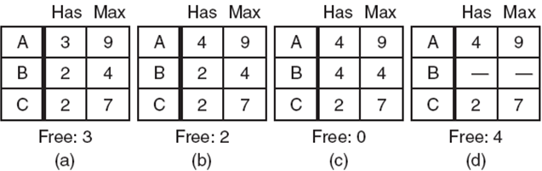
Deadlock Avoidance Safe and Unsafe States – Demo 2
3 processes, 1 resource with 10 instances: Situation for unsafe state.
Tanenbaum, Fig. 6-10.
(1) Fig (a) →A runs, a resource is requested → fig. (b)→ B requests 2 resouces → fig. (c) → B ruuns then terminates, resourced are deallocated → free:4 , fig. (d) → the system can not allocate resources that are required by the processes A anc C ➔ unsafe state.

Slide 37
Deadlock Avoidance The Banker’s Algorithm for a Single Resource
Is used to avoid and detect deadlock.
Ideas: A small-town banker might deal with a group of customers to whom he has granted lines of credit (to making loan requests time to time)
Algorithm:
Considers each request as it occurs, and sees if granting it leads to a safe state.
If it does, the request is granted; otherwise, it is postponed until later.
To see if a state is safe, the banker checks to see if he has enough resources to satisfy some customer.
If so, those loans are assumed to be repaid, and customer now closest to the limit is checked.
If all loans can eventually be repaid, the state is safe and the initial request can be requested.

Slide 38
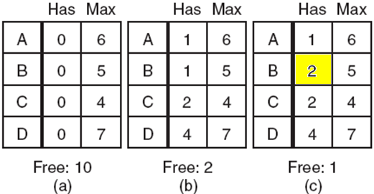
Deadlock Avoidance The Banker’s Algorithm for a Single Resource
10 units with maximum of 22 requests
(a); Safe state, obviously.
(b): Safe state, 2 resources can allocate to C’s request. C runs exclusively then terminates, 4 resources are deallocated then they can be allocated to other request.
(c): unsafe state because the system can not fully supply resources for any request.
(a): Safe. (b) Safe. (c): Unsafe
Tanenbaum, Fig. 6-11.

Slide 39
Deadlock Avoidance The Banker’s Algorithm for a Multiple Resource
Algorithm for checking to see if a state is safe:
Look for row, R, whose unmet resource needs all ≤ A. If no such row exists, system will eventually deadlock since no process can run to completion.
Assume process of row chosen requests all resources it needs and finishes. Mark process as terminated, add all its resources to the A vector.
Repeat steps 1 and 2 until either all processes marked terminated (initial state was safe) or no process left whose resource needs can be met (there is a deadlock).
Disadvantages:
It is essentially useless because process rarely know in advance what their maximum resource needs will be.
The number of processes is not fixed, but dynamically varying.
Resources that were thought to be available can suddenly vanish (biến mất).

Slide 40
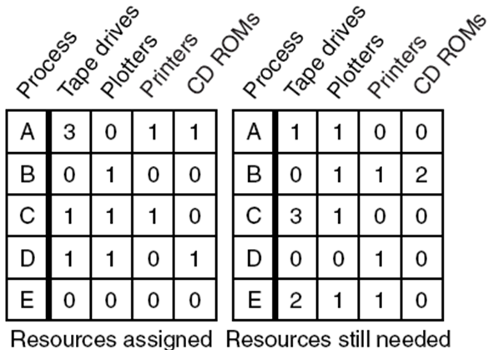
Deadlock Avoidance The Banker’s Algorithm for a Multiple Resource
Resources in existence:
E = ( 6 3 4 2 )
Possessed resources:
P = ( 5 3 2 2 )
Resources available:
A = ( 1 0 2 0 )
A=( 1 0 2 0) → Only the process D is supported.
Progress: D, E, A, B, C
Tanenbaum, Fig. 6-11.

Slide 41
Deadlock Avoidance The Banker’s Algorithm for a Multiple Resource
Allocated | Needed | A (available) | Descriptrion
A 3 0 1 1 B 0 1 0 0 C 1 1 0 1 D 1 1 0 1 E 0 0 0 0 | 1 1 0 0 0 1 1 2 3 1 0 0 0 0 1 0 2 1 1 0 | 1 0 2 0 | The process D’s requests are accepted, other requests are blocked.
A 3 0 1 1 B 0 1 0 0 C 1 1 0 1 D 1 1 1 1 E 0 0 0 0 | 1 1 0 0 0 1 1 2 3 1 0 0 0 0 0 0 2 1 1 0 | 1 0 1 0 | All requests are blocked. The system wait for the D’s termination
A 3 0 1 1 B 0 1 0 0 C 1 1 0 1 D 0 0 0 0 E 0 0 0 0 | 1 1 0 0 0 1 1 2 3 1 0 0 0 0 0 0 2 1 1 0 | 2 1 2 1 | D terminates, resources possessed by D are deallocated. Avalable resources can be assigned to A
A 4 1 1 1 B 0 1 0 0 C 1 1 0 1 D 0 0 0 0 E 0 0 0 0 | 0 0 0 0 0 1 1 2 3 1 0 0 0 0 0 0 2 1 1 0 | 1 0 2 1 | A runs then terminates
A 0 0 0 0 B 0 1 0 0 C 1 1 0 1 D 0 0 0 0 E 0 0 0 0 | 0 0 0 0 0 1 1 2 3 1 0 0 0 0 0 0 2 1 1 0 | 5 1 3 2 | Resources sre asigned to B … and so on ….

Slide 42
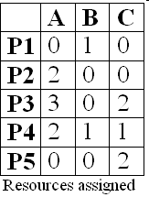
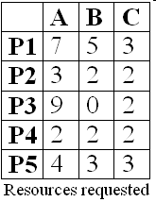
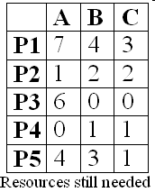
Deadlock Avoidance The Banker’s Algorithm for a Multiple Resource
E= ( 10, 5, 7)
P= ( 7 ,2, 5)
A ( 3, 3, 2)
DO YOURSELF
No Process deadlock
(Check yourself)

Slide 43
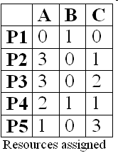
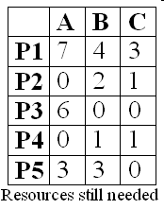
Deadlock Avoidance The Banker’s Algorithm for a Multiple Resource
E= ( 10, 5, 7)
P= ( 9 ,2, 7)
A ( 1, 3, 0)
DO YOURSELF
All Process are deadlocked

Slide 44
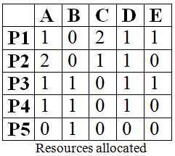
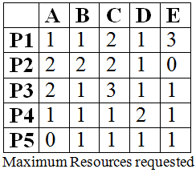
Deadlock Avoidance The Banker’s Algorithm for a Multiple Resource
Resources available
A = ( 0, x, y, 1, 1)
What is the smallest value of x and y for which this is a safe state? And which progress of processes?
With the range of x and y is [0,9]
x=y=1
The progress is P4, P5, P1, P2, P3 CHECK YOURSELF

Slide 45
Deadlock Prevention Attacking the Mutual Exclusion Condition
Loại trừ hỗ tương.
The first condition for deadlocks occuring.
Avoiding assigning a resource when that is not absolutely necessary, and
Try to make sure that as few processes as possible may actually claim (thình cầu, xin) the resource.
Ex: spooling and daemon in printer

Slide 46
Deadlock Prevention Attacking the Hold and Wait Condition`
The second condition for deadlocks occuring.
Before a resource is assigned to a process:
Must guarantee that whenever a process requests a resource, it does not hold any other resources, or
Prevent process that holds resource from waiting for more resources or
Others: require a process requesting a resource to first temporarily release all the resource it currently holds, then it tries to get everything it needs all at one.
➔ All processes need to request all their resources before starting execution.
If everything is available, the process will be allocated whatever it needs and can run to completion.
If one ore more resources are busy, nothing will be allocated and the process would just wait.

Slide 47
Deadlock Prevention Attacking the Hold and Wait Condition
Problems
Many process do not know how many resources they will need until they have started running.
Resources will not be used optimally.
Disadvantages: put a burden (gánh nặng) on the programmer and waste resource.
Advantages: prevent deadlocks and can be applied to batch system.

Slide 48
Deadlock Prevention Attacking the No Preemption Condition
The third condition for deadlocks occuring.
If a process that is holding some resources requests another resource then the resource cannot be immediately allocated to it but all resources currently being held are released.
Preempted resources are added to the list of resources for which the process is waiting.
Process will be restarted only when it can regain its old resources, as well as the new ones that it is requesting.
Some recourse can be virtualized to avoid the first condition such as spooling and daemon.

Slide 49
Deadlock Prevention Attacking the Circular Wait Condition
The fourth condition for deadlocks accuring.
First approach
A process is entitled (cho quyền) only to a single resource at the moment.
If it needs a second one, it must release the first one.
➔ If a process needs to copy a huge file from a tape to a printer, this restriction is unacceptable.
Second approach
Provide a global numbering of the resources.
Process can request resources whenever they want to, but all requests must be made in numerical order.
➔ The resource allocation graph can never have cycles but the numerically ordering the resources may be impossible to find an ordering that satisfies every ones.

Slide 50
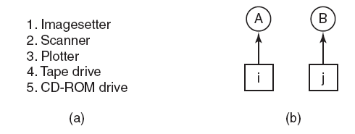
Deadlock Prevention Attacking the Circular Wait Condition
Numerically ordered resources.
(b) A resource graph
Tanenbaum, Fig. 6-13.
Deadlock occurs only if A request j and B request i (i ≠ j)
If i>j, the A is not allowed to request j because that is lower than what it already has.
If i<j, the B is not allowed to request i because that is lower than what is already has.
➔ deadlock is impossible.

Slide 51
Deadlock Prevention Attacking the Circular Wait Condition
With more than two processes:
At every instant, one of the assigned resources will be highest.
The process holding that resource will never ask for a resource already assigned.
It will either finish, or at worst, request even higher numbered resources, all of which are available.
Eventually, it will finish and free resources. At this point, some other process will hold the highest resource and can also finish.
➔ All processes finish, so no deadlock occurs.
A minor variation of the algorithm:
Drop the requirement that resource be acquired in strictly increasing sequence and merely insist (van nài) that no process requests a resource lower than what it is already holding.

Slide 52
Deadlock Prevention Summarized
Condition | Approach
Mutual exclusion | Spooling every thing
Hold and wait | Request all resources initially
No preemption | Take resources away
Circular wait | Order resources numerically
Tanenbaum, Fig. 6-14.

Slide 53
Other Issues Two-Phase Locking
Context
In many DB systems, an operation that occurs frequently is requesting locks on several records and then updating all the locked records.
When multiple processes are running at the same time, there is a real danger of deadlock.

Slide 54
Other Issues Two-Phase Locking
Two-phase locking;
First phase, the process tries to lock all records it needs, one at a time. No real work is done in the first phase. If some records can not be locked, all records are released.
If it succeeds, it begins the second phase, performing its updates and releasing the locks (then starts the first phase all over)
➔Request all the resources needed in advance, or at least before anything irreversible is done.
There is no release and restart of a locked record is encountered during the first phase → deadlock can occur.
This strategy is not applicable in general for many applications (except DB systems)
To apply, the programmer has very carefully arranged things so that the program can be stopped at any point during the first phase and restart.

Slide 55
Other Issues Communication Deadlocks
Deadlock can occur in communication system in which two or more process communicate by sending message.
Problems
Process A sends a request message to process B, then blocks until B sends back reply the message
If the request message gets lost, both A and B are blocked
Communication deadlock
The set of processes are deadlock if each blocked waiting for an event only the other one can cause.
Cannot be prevented by ordering the resource (since there are none) or avoided by careful scheduling (since there are no moments when a request could be postponed)
➔ Deadlock is prevented using timeout (or handling alarm).

Slide 56
Other Issues LiveLock
Context
Mutual exclusion
Busy waiting
Definition
Each process acquires one resource, but it is not progressing because it uses up its CPU quantum over and over to checking to take/ enter the resource/ critical regions (in the other word, it is running)
➔ It is the equivalent of deadlock but no process is blocked (and it is similar to starvations because the process must wait for a long time).

Slide 57
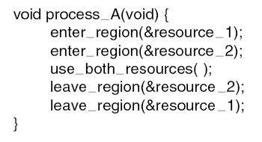
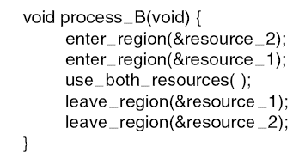
Other Issues LiveLock
Both of processes are checking to enter a common resource.
Tanenbaum, Fig. 6-16.

Slide 58
Other Issues LiveLock
Case studies
The process table slots are finite resource. When the table is full, the live-lock occurs due to wait a random time and try again to enter the process table.
Same as the i-node table slots to open files are finite resource.
Solutions
Abolish (huỷ bỏ) all the finite resources and each items can claim 1/n of the total (fairness is not a good idea)
Most OS just ignore the problem on the assumption that most users would prefer an occasional livelock to rule restricting all users to one process, one open file, and one everything.
➔Face with an unpleasant trade-off between convenience and correctness.

Slide 59
Other Issues Starvation
Some policy is needed to make a decision about who gets which resource when.
➔ It may lead to some processes never getting service even though they are not deadlocks.
Ex: A dinner philosophers problems
To avoid starvation
The FCFS- First Come First Serve-is used for resource allocation policy.
Disadvantages: the process waiting the longest gets served next.

Slide 60
Summary
Resources
Introduction To Deadlocks
The Ostrich Algorithm
Deadlock Detection & Recovery
Deadlock Avoidance
Deadlock Prevention
Other Issues
Q&A

Slide 61
Your work
Write down main idea of this lesson.
If you do not, you will be considered as absent in the next class.

